Slide 1



TECHNICAL OVERVIEW
@FOLIO_LSP
Mike Taylor | Index Data, LLC

Slide 2

Index Data
Information toolmakers
Standards-based solutions
Long experience and practice in open source
23 years providing solutions for libraries and others

Slide 3

Mike Taylor
Formal job title is “software guy”
37 years experience in programming
16 years with Index Data
FOLIO front-end team
Based in Gloucestershire, England
Really unhappy and completely baffled about Brexit.

Slide 4
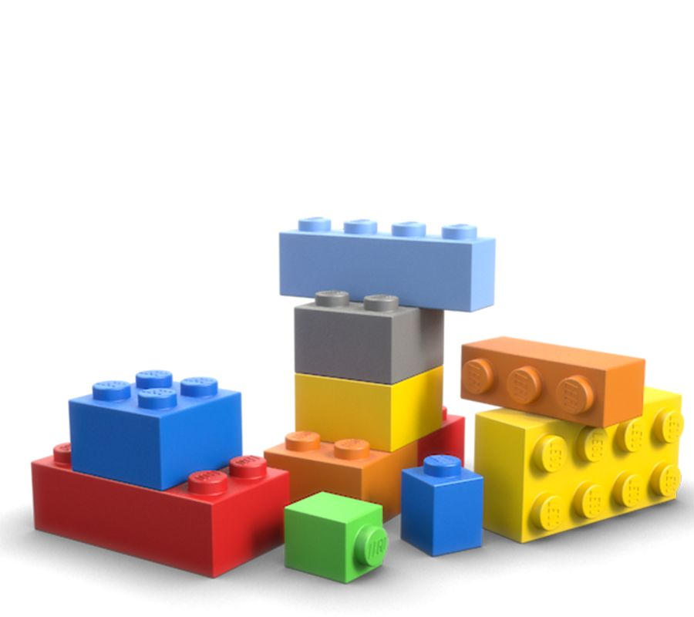
An open source
Library Services Platform
An open Platform
For building Services
For Libraries
what is FOLIO?
Notes:
Choral singer platform

Slide 5
“...a vibrant and healthy platform is dependent on the value created by partners who are outside the platform itself. If a platform is too closed, then partners cannot or will not contribute.”
From Platform Revolution, by Parker, Van Alstyne, and Choudary
what makes FOLIO a platform?
Notes:
Standards: HTTP, JSON
Interfaces: REST, RAML (RESTful API Modeling Language), JSON Schema
Processes: Product council, SIGs, UX-driven design
Tools: RMB, Stripes

Slide 6
“...a vibrant and healthy platform is dependent on the value created by partners who are outside the platform itself. If a platform is too closed, then partners cannot or will not contribute.”
From Platform Revolution, by Parker, Van Alstyne, and Choudary
Open standards
HTTP, JSON
what makes FOLIO a platform?
Notes:
Standards: HTTP, JSON
Interfaces: REST, RAML (RESTful API Modeling Language), JSON Schema
Processes: Product council, SIGs, UX-driven design
Tools: RMB, Stripes

Slide 7
“...a vibrant and healthy platform is dependent on the value created by partners who are outside the platform itself. If a platform is too closed, then partners cannot or will not contribute.”
From Platform Revolution, by Parker, Van Alstyne, and Choudary
Open standards
Open interfaces
HTTP, JSON
REST, RAML, JSON Schema
what makes FOLIO a platform?
Notes:
Standards: HTTP, JSON
Interfaces: REST, RAML (RESTful API Modeling Language), JSON Schema
Processes: Product council, SIGs, UX-driven design
Tools: RMB, Stripes

Slide 8
“...a vibrant and healthy platform is dependent on the value created by partners who are outside the platform itself. If a platform is too closed, then partners cannot or will not contribute.”
From Platform Revolution, by Parker, Van Alstyne, and Choudary
Open standards
Open interfaces
Open tools
HTTP, JSON
REST, RAML, JSON Schema
RAML Module Builder, Stripes
what makes FOLIO a platform?
Notes:
Standards: HTTP, JSON
Interfaces: REST, RAML (RESTful API Modeling Language), JSON Schema
Processes: Product council, SIGs, UX-driven design
Tools: RMB, Stripes

Slide 9
“...a vibrant and healthy platform is dependent on the value created by partners who are outside the platform itself. If a platform is too closed, then partners cannot or will not contribute.”
From Platform Revolution, by Parker, Van Alstyne, and Choudary
Open standards
Open interfaces
Open tools
Open processes
HTTP, JSON
REST, RAML, JSON Schema
RAML Module Builder, Stripes
Product council, SIGs, UX-driven design
what makes FOLIO a platform?
Notes:
Standards: HTTP, JSON
Interfaces: REST, RAML (RESTful API Modeling Language), JSON Schema
Processes: Product council, SIGs, UX-driven design
Tools: RMB, Stripes

Slide 10
Extensible from the ground up
inspired by microservices
Notes:
Extensible from the ground up
Development stack neutral (polyglot)
Agreed upon interfaces (contracts), not implementation
Cloud/enterprise ready
Scalability baked in
Multi-tenant from the ground up

Slide 11
Extensible from the ground up
Development stack neutral (polyglot)
  Agreed upon interfaces (contracts), not implementation
inspired by microservices
Notes:
Extensible from the ground up
Development stack neutral (polyglot)
Agreed upon interfaces (contracts), not implementation
Cloud/enterprise ready
Scalability baked in
Multi-tenant from the ground up

Slide 12
Extensible from the ground up
Development stack neutral (polyglot)
  Agreed upon interfaces (contracts), not implementation
Cloud/enterprise ready
  Scalability baked in
inspired by microservices
Notes:
Extensible from the ground up
Development stack neutral (polyglot)
Agreed upon interfaces (contracts), not implementation
Cloud/enterprise ready
Scalability baked in
Multi-tenant from the ground up

Slide 13
Extensible from the ground up
Development stack neutral (polyglot)
  Agreed upon interfaces (contracts), not implementation
Cloud/enterprise ready
  Scalability baked in
Multi-tenant from the ground up
inspired by microservices
Notes:
Extensible from the ground up
Development stack neutral (polyglot)
Agreed upon interfaces (contracts), not implementation
Cloud/enterprise ready
Scalability baked in
Multi-tenant from the ground up

Slide 14
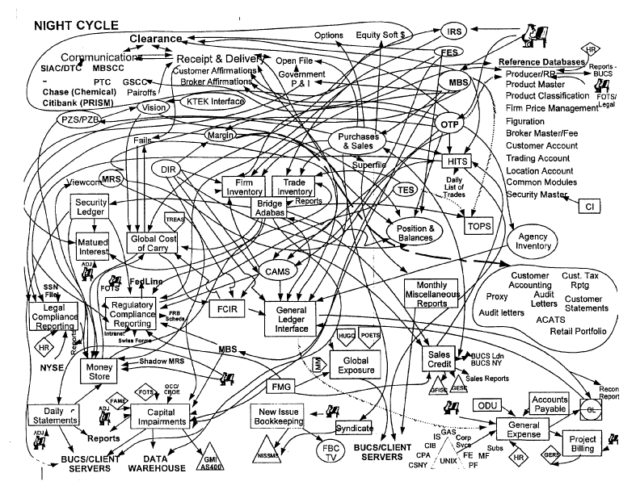
but it’s not microservices
Notes:
Extensible from the ground up
Development stack neutral (polyglot)
Agreed upon interfaces (contracts), not implementation
Cloud/enterprise ready
Scalability baked in
Multi-tenant from the ground up

Slide 15
but it’s not microservices
Notes:
Extensible from the ground up
Development stack neutral (polyglot)
Agreed upon interfaces (contracts), not implementation
Cloud/enterprise ready
Scalability baked in
Multi-tenant from the ground up

Slide 16
UI module
UI module
UI module
Back-end
module
Back-end
module
Back-end module
“mesoservices”
Notes:
Extensible from the ground up
Development stack neutral (polyglot)
Agreed upon interfaces (contracts), not implementation
Cloud/enterprise ready
Scalability baked in
Multi-tenant from the ground up

Slide 17
UI module
UI module
UI module
Front end
Back-end
module
Back-end
module
Back-end module
Back end
“mesoservices”
Notes:
Extensible from the ground up
Development stack neutral (polyglot)
Agreed upon interfaces (contracts), not implementation
Cloud/enterprise ready
Scalability baked in
Multi-tenant from the ground up

Slide 18
Users app
Items app
Requests app
UI module
UI module
UI module
Back-end
module
Back-end
module
Back-end module
“mesoservices”
Notes:
Extensible from the ground up
Development stack neutral (polyglot)
Agreed upon interfaces (contracts), not implementation
Cloud/enterprise ready
Scalability baked in
Multi-tenant from the ground up

Slide 19

Proxy server
Service and tenant lifecycle management
Service discovery
Dependency resolution
Enforces FOLIO security model
Language agnostic (polyglot)
the FOLIO API gateway: Okapi

Slide 20
Vert.x (Java)
HTTP transport
RESTful application protocols
JSON message interchange
Hazelcast clustering
the FOLIO API gateway: Okapi (technical details)
Notes:
Vert.x: polyglot, nonblocking, event driving networking toolkit
HTTP semantics (GET, PUT, POST, DELETE) and statelessness
RESTful conventions

Slide 21
Items
UI module
Okapi gateway
conceptual architecture

Slide 22
Items
UI module
Okapi gateway
Items
backend module
conceptual architecture

Slide 23
Users
UI module
Items
UI module
Okapi gateway
Users-BL
backend module
Items
backend module
conceptual architecture

Slide 24
Users
UI module
Items
UI module
Requests
UI module
Okapi gateway
Users-BL
backend module
Items
backend module
Requests
backend module
conceptual architecture

Slide 25
Users
UI module
Items
UI module
Requests
UI module
Okapi gateway
Users-BL
backend module
Items
backend module
Requests
backend module
conceptual architecture

Slide 26
Users
UI module
Items
UI module
Requests
UI module
Okapi gateway
Users-BL
backend module
Items
backend module
Requests
backend module
Users
backend module
conceptual architecture

Slide 27
Users
UI module
Items
UI module
Requests
UI module
Okapi gateway
Users-BL
backend module
Items
backend module
Requests
backend module
Users
backend module
conceptual architecture

Slide 28
Users
UI module
Items
UI module
Requests
UI module
Okapi gateway
Users-BL
backend module
Items
backend module
Requests
backend module
Users
backend module
items-storage
backend module
conceptual architecture

Slide 29
Users
UI module
Items
UI module
Requests
UI module
Okapi gateway
Users-BL
backend module
Items
backend module
Requests
backend module
Users
backend module
items-storage
backend module
conceptual architecture

Slide 30
Users
UI module
Items
UI module
Requests
UI module
Users-BL
backend module
Items
backend module
Requests
backend module
Users
backend module
items-storage
backend module
conceptual architecture

Slide 31
Stripes: “an opinionated and modular platform for React components consuming REST data”
Folio UI: SPA with rich client/browser technologies.
what is a FOLIO app?

Slide 32
Stripes: “an opinionated and modular platform for React components consuming REST data”
Folio UI: SPA with rich client/browser technologies.
Built on React and Redux: hiding intricate state handling details behind declarative semantics. Modular by design.
what is a FOLIO app?

Slide 33
Stripes: “an opinionated and modular platform for React components consuming REST data”
Folio UI: SPA with rich client/browser technologies.
Built on React and Redux: hiding intricate state handling details behind declarative semantics. Modular by design.
Stripes modules: React components (from small widgets to full pages) with additional metadata and NPM packaging.
what is a FOLIO app?

Slide 34
Stripes: “an opinionated and modular platform for React components consuming REST data”
Folio UI: SPA with rich client/browser technologies.
Built on React and Redux: hiding intricate state handling details behind declarative semantics. Modular by design.
Stripes modules: React components (from small widgets to full pages) with additional metadata and NPM packaging.
Static JavaScript bundle generated for tenant after module selection.
what is a FOLIO app?

Slide 35
Stripes: “an opinionated and modular platform for React components consuming REST data”
Folio UI: SPA with rich client/browser technologies.
Built on React and Redux: hiding intricate state handling details behind declarative semantics. Modular by design.
Stripes modules: React components (from small widgets to full pages) with additional metadata and NPM packaging.
Static JavaScript bundle generated for tenant after module selection.
Decoupled from, but with explicit machine-readable dependencies on, backend services and data.
what is a FOLIO app?

Slide 36
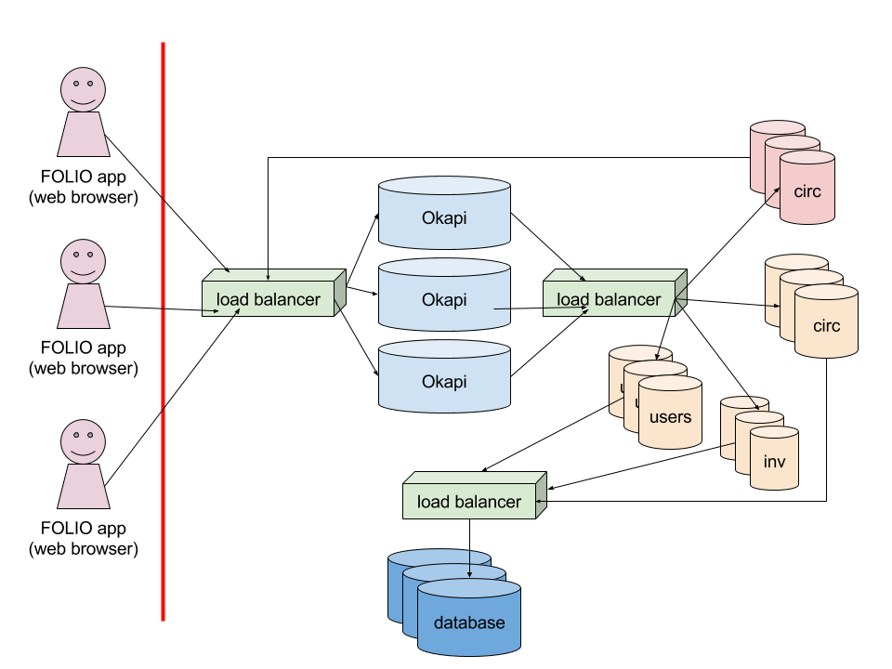
We have people ensuring scalability and redundancy

Slide 37
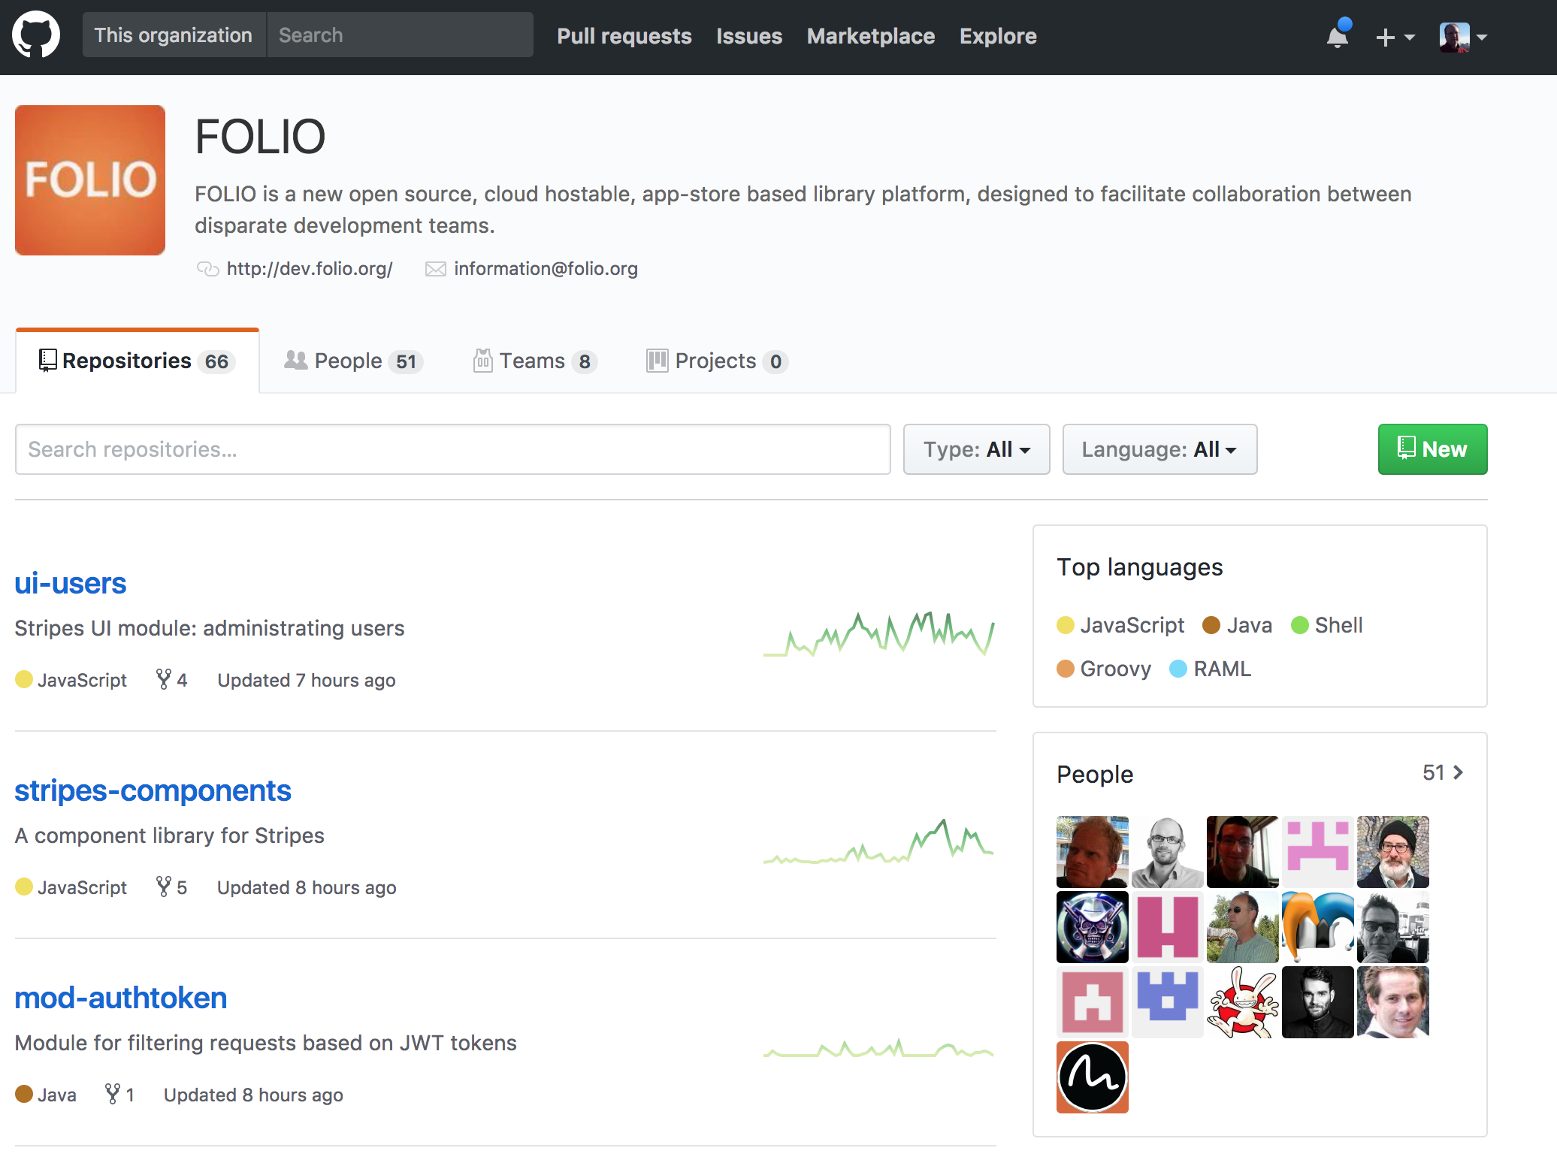
let’s talk about community
Notes:
Transparent development
GitHub, JIRA, Wiki, Discuss, Slack
GitFlow: fork, branch, pull request

Slide 38
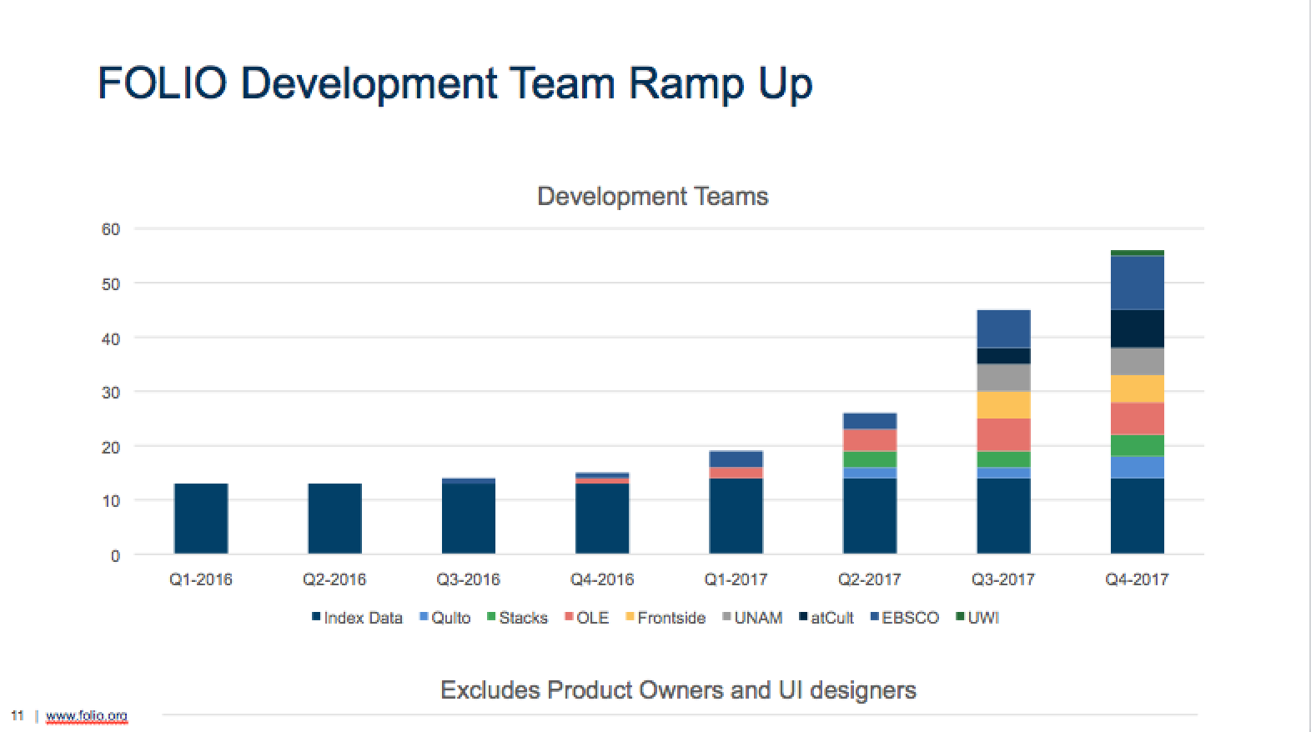

Slide 39
https://github.com/indexdata/glint
  glint — shareable data sets
https://github.com/folio-labs
  mod-ncip — NCIP Interface for OKAPI
  folio-mobile-patron — UI for phones
https://github.com/thefrontside/ui-eholdings
  FOLIO e-holdings App
community-contributed modules
Notes:
Glint -- first community contributed module for managing research datasets, in Go
FOLIO labs -- “pho” Go library for interacting with Okapi, NCIP responder in JavaScript

Slide 40
Main website
https://www.folio.org/
Developers’ website
http://dev.folio.org/
The code
https://github.com/folio-org/
Vagrant box of current running code
https://github.com/folio-org/folio-ansible#quick-start
Special Interest Groups
https://wiki.folio.org/
how do I get involved?

Slide 41
TECHNICAL OVERVIEW
@FOLIO_LSP
Mike Taylor | Index Data, LLC

